Slide 1







x
BANK MUAMALAT
BUSINESS INTELLIGENCE ANALYST
Project Based Internship
Batch April 2024
Presented by Fajar Wahyu Pratama

Slide 2

Introduction
Fajar Wahyu Pratama
Hello!!
I am a third-year undergraduate student majoring in mathematics at Institut Teknologi Sepuluh Nopember Surabaya who has a great interest in data. Someone who is committed, analytical, responsible, and able to adapt to changing circumstances with new knowledge and perspectives.
Experience
Sponsorship Staff
Olimpiade Matematika ITS 16TH
(OMITS 16TH)
(Mar 2023 - Nov 2023 )
Manager Sponsorship
TDC Summit Fest 2022
(Jul 2022 - Oct 2022)
Web Developer
Subdirektorat Koordinasi
Perkuliahan Bersama / SKPB ITS
(Dec 2024 - Feb 2024)
Legal Advisor
Tecnopreneurship Development
Center (TDC ITS)
(Feb 2023 - Jan 2024)
Arabic and Nahwu Teacher
Madrasah Diniyah Alhidayah
Lebaksono
(Jun 2020 - Feb 2022)
This project is the result of my final project, as a Business Intelligence Analyst Intern who has understood the business data at Bank Muamalat, I am tasked with creating a dashboard from the raw data that has been provided.

Slide 3


CASE STUDY

Slide 4





Overview
As a data analyst, we are given 4 datasets that can be used and processed for
provide conclusions and suggestions for internal companies
increase sales.
01
Determine each primary key in the 4 datasets sales
02
Determine the relationships among the four tables.
03
As a BI Analyst, we will create a master table containing important information and sorted by order date.
Using Looker Studio, a visualization that displays the sales data will be created.
04
As a BI analyst, what can you propose to maintain sales or increase sales with the existing detailed transaction table already exist?
Data Source : https://drive.google.com/file/d/1RwsBQ1FriNfz6qiq0V5nD7gF7jO81To3/view?usp=sharing
05

Slide 5





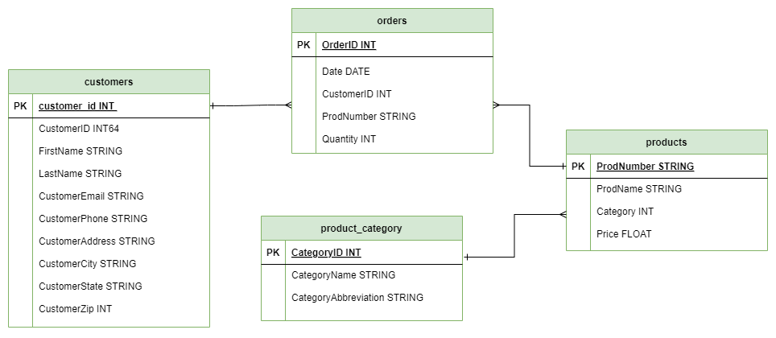
Primary Key
A primary key is a column in a database table that has a unique value for each row and is not allowed to have a null value. Primary keys are used to uniquely identify each row in a table, ensure data integrity and facilitate database operations such as searching and merging data.
Primary key of Customer Table: CustomerID
Primary key Products Table: ProdNumber
Primary key Orders Table: OrderID
Primary key ProductCategory Table: CategoryID
Entity Relationship Diagram (ERD)
There are 3 common types of table relationships that we often encounter when designing a database:
One to One : a relationship where a row in table A is only related to one row in table B.
One to Many: a relationship where a row in table A has a relationship to multiple rows in table B.
Many to Many: a relationship where more than one row of data from table A is related to more than one row of data in table B.

Slide 6


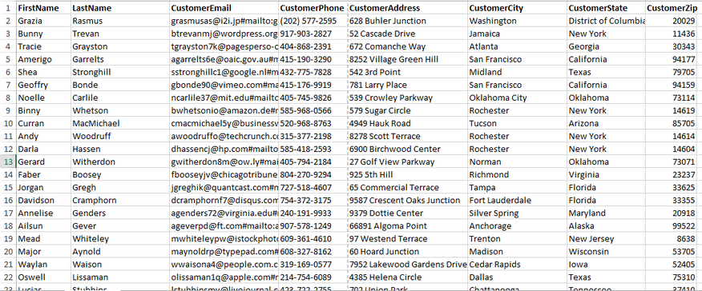
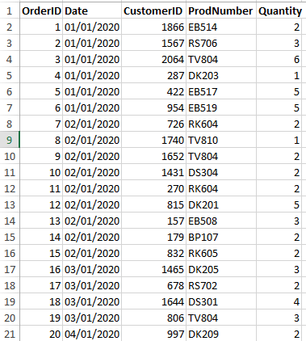
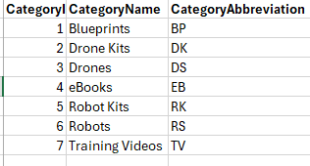
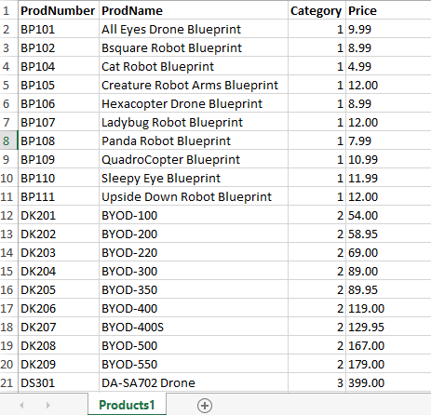
Google BigQuery
The master table is created by combining all tables to get the features that will be included in the dashboard. We will create a master table that contains information:
CustomerEmail (cust_email)
CustomerCity (cust_city)
OrderDate (order_date)
OrderQty (order_qty)
ProductName (product_name)
ProductPrice (product_price)
ProductCategoryName (category_name)
TotalSales (total_sales)
Sort the data based on the earliest to latest transaction date the earliest to the latest.

Slide 7
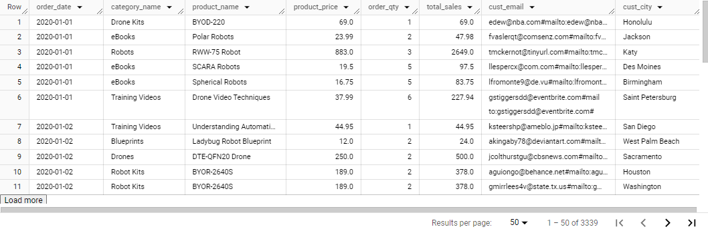
Google BigQuery
Output :
Source Code :
SELECT
Orders.Date AS order_date,
ProductCategory.CategoryName as category_name,
Products1.ProdName AS product_name,
Products1.Price AS product_price,
Orders.Quantity AS order_qty,
ROUND((Products1.Price * Orders.Quantity),2) as total_sales,
Customers.CustomerEmail AS cust_email,
Customers.CustomerCity AS cust_city
FROM
pbi-project-muamalat.PBI_project_muamalat.Customers
JOIN pbi-project-muamalat.PBI_project_muamalat.Orders Orders ON Customers.CustomerID = Orders.CustomerID
JOIN pbi-project-muamalat.PBI_project_muamalat.Products1 Products1 ON Products1.ProdNumber = Orders.ProdNumber
JOIN pbi-project-muamalat.PBI_project_muamalat.ProductCategory ProductCategory ON ProductCategory.CategoryID = Products1.Category
ORDER BY 1,5 ASC

Slide 8


Looker Studio
Looker Studio (formerly Google Data Studio) is one of the built-in visualization tools Google that makes it easy for us to do data visualization.
From the results of the table created in the previous master table, save the results in CSV form. Using Looker Studio, create a visualization that displays the sales data. data. The visualization must contain at least :
- Total sales
- Grand total sales by product category
- Total qty by product category
- Total sales by city
- Total qty by city
- Top 5 product categories with the highest sales
- Top 5 product categories with the highest qty

Slide 9
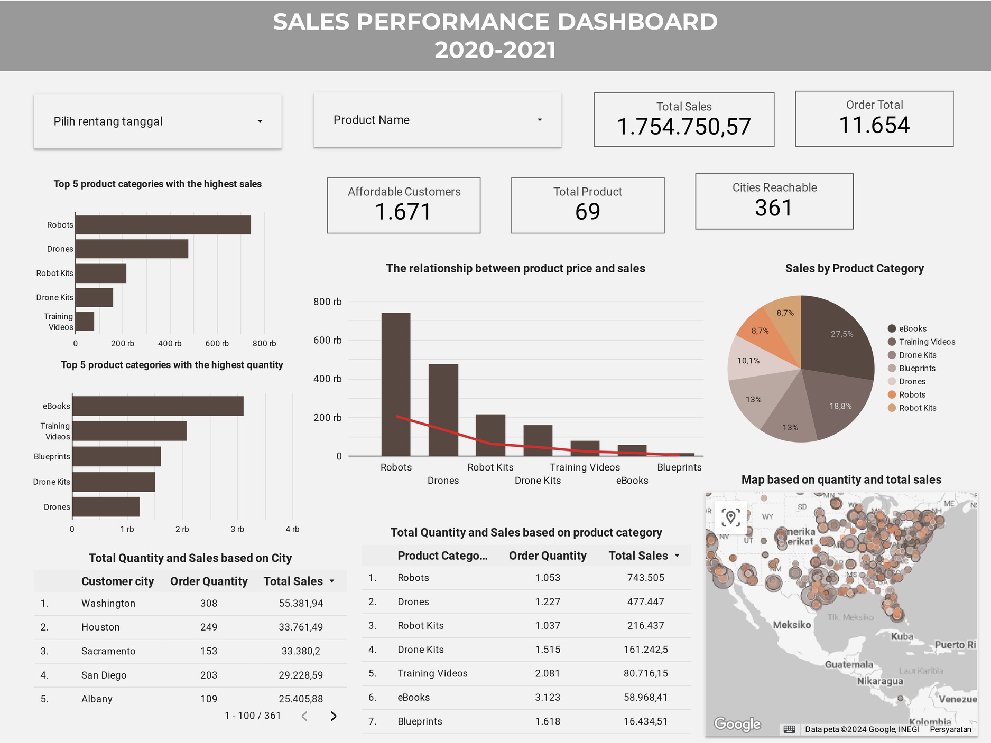

Slide 10




Relationship between Price and Products Sold:
There is a negative relationship between product price and items sold. This suggests that distribution and price optimization can increase sales. However, price optimization must be accompanied by product innovation to maintain demand.
Conclusion
Sales Dominance and Items Sold:
The city of Washington dominated total quantity and total sales. The Robot product category dominates sales, while the eBooks category dominates items sold. This suggests a discrepancy between consumer preferences and marketing strategies that needs to be further analyzed.
Product Category Performance:
Sales of eBooks and Training Videos are less effective as they have high sales quantity but low sales revenue. In contrast, the Robots and Drones category has the highest sales and contributes up to 50% of the total sales. Therefore, it is recommended to allocate more marketing budget and resources to the Robots and Drones category.
Regional Sales Gap:
There is a significant sales gap between urban and suburban areas. In urban areas, not all cities have high sales rates. For example, Indianapolis has a low sales rate. This suggests the need for specific strategies to increase sales in high-potential urban areas like Indianapolis.

Slide 11






Recomendation
01. Expand Marketing Reach
Develop new marketing strategies to stimulate sales growth in regions other than Washington City.
02. Emphasis on Top Product Categories
Focus on promoting Robots product categories that have high sales potential, but also pay attention to other categories that have potential.
03. Optimize Pricing and Inventory:
Make price adjustments based on the positive relationship between price and sales to increase sales volume. Also, optimize the inventory of the eBooks product category which has high demand.
04. Periodic Evaluation:
Conduct periodic evaluations to keep up with market trends and changes. Adjust marketing strategies effectively based on the evaluation results.

Slide 12





x
THANK YOU
Fajar Wahyu Pratama
Dashboard Performance here
Github File
fajarpratam413@gmaail.com
www.linkedin.com/in/fajar-wahyu-pratama
Surabaya, East Java

